Slide 1


CASE STUDY
Rahul Wire Case Study: How IOTMATRIX Safeguards Against Energy Wastage and Prevents Peak Demand Penalties
✓
EXECUTIVE SUMMARY
Client
Rahul Wire
Industry
Wire & Cable Manufacturing / Industrial Engineering
Location
Bhiwadi, Rajasthan 301019
Core Challenge
Machines drawing power around the clock with nobody watching, an electricity bill that moved for no clear reason, and equipment problems that only came to light after something broke.
Solution Implemented
IOTMATRIX implemented a PLC with machine-wise energy and power-quality monitoring. We added a relay-input controller and an incoming meter reporting into one live dashboard, with automatic alarms and a peak demand limit.
KEY RESULTS
14 machines metered around the clock, night shift included
1,641 abnormal power events caught automatically in a single monitored window
100% of stoppages now tied to a recorded reason, not a guess
RAHUL WIRE · CASE STUDY
01

Slide 2
Client Profile & The Six Problems We Found
2
CLIENT PROFILE & BACKGROUND
Rahul Wire runs a wire and cable manufacturing floor with 14 bunching machines, all drawing power from a single 415V / 1,600A incomer. Operating out of their primary manufacturing facility. The plant runs multiple shifts, which is exactly where these problems were hardest to catch.
3
THE CHALLENGE
Six things were costing Rahul Wire money every month, and nobody on the floor could see any of them:
Idle machines still burned power at night
The electricity bill moved and nobody knew why
A machine sitting idle after the day shift ended could still be pulling current, and nobody was on the floor at 2 AM to notice.
A jump in peak demand could push the whole month's bill up, but by the time it arrived there was no way to trace it back to a cause.
No one knew which machine was using how much power
Faults built up quietly before a machine failed
With India-make and China-make machines running side by side, a high reading on any one of 14 machines was impossible to isolate.
A motor running hot or a phase drawing more current than it should happens well before a breakdown — but nobody was watching for it.
Maintenance always came after something broke
Nothing alerted anyone when something went wrong
There was no way to tell which machine was heading for trouble. The team found out the same way every time: the machine stopped.
A current surge or a voltage dip went unnoticed until someone walked the floor, or until the damage was already done.
RAHUL WIRE · CASE STUDY
02

Slide 3
The Solution: What Changed, Problem by Problem
4
WHY RAHUL WIRE CHOSE IOTMATRIX
Rahul Wire didn't need another report at the end of the month. It needed to see, in real time, what every machine was doing with power — and to know the moment something looked wrong. They want transparent visibility of energy consumption across the plant, whether it is about a machine, compressor, chiller, motor or plant facilities energy consumption. That's what IOTMATRIX deliver them.
WHAT CHANGED, ONE PROBLEM AT A TIME
Idle machines are visible at night too
Peak demand is visible before it hits the bill
Current, KVA and power factor on the incomer are tracked live, so a demand spike shows up while it's happening, not a month later.
Every machine's current draw is logged around the clock, so power pulled while idle shows up on the same screen as daytime production.
Every machine's power draw is now attributed
Abnormal running is caught early
All 14 machines report their own voltage and current. If one pulls more than it should, it shows up on its own line, not buried in a total.
Voltage, current, power factor and harmonics are tracked per machine against normal bands, so a motor drifting out of range shows up before it fails.
Maintenance calls are now based on evidence
Alerts go out the moment something happens
Repeated low-voltage or high-current events on the same machine are now a pattern the dashboard surfaces on its own, not something maintenance has to guess at.
A voltage dip, a current surge or an unusual consumption pattern raises an automatic alarm, instead of waiting for someone to notice.
RAHUL WIRE · CASE STUDY
03

Slide 4
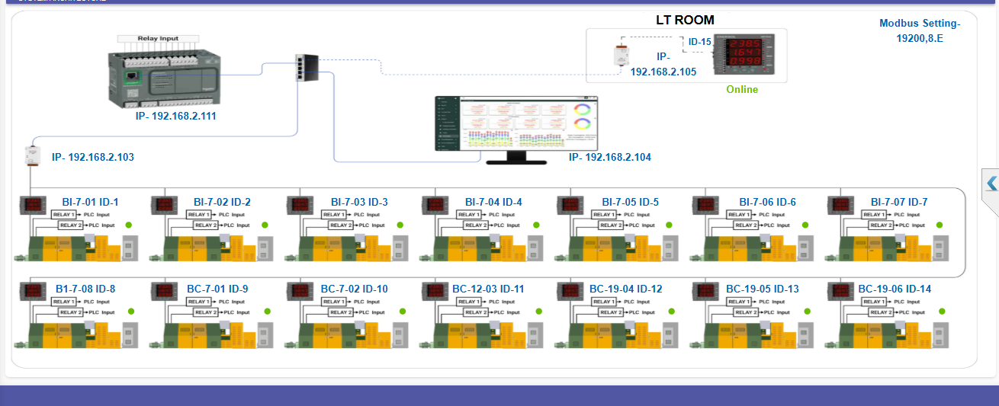
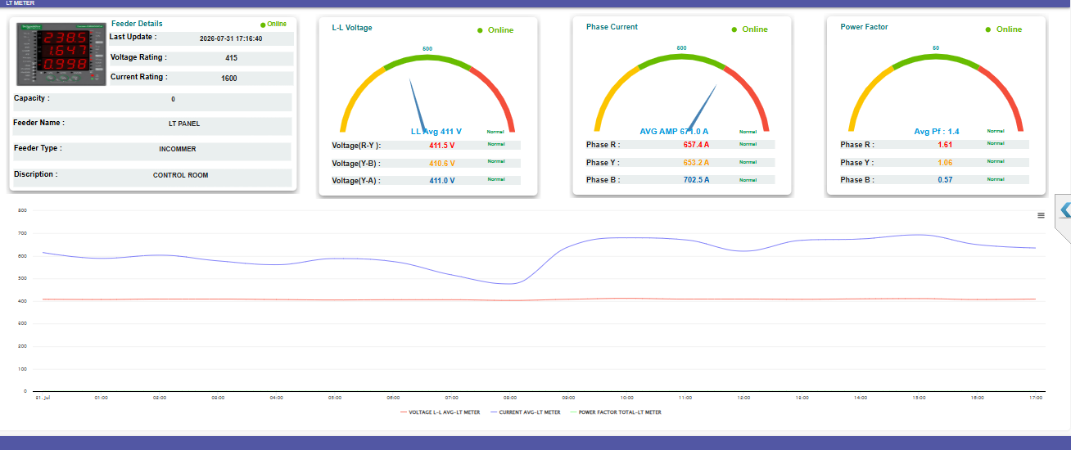
How It Was Rolled Out
5
IMPLEMENTATION
IOTMATRIX implements PLC, relay-input controllers, meters & CT/PT Sensor integrations, and a live IoT monitoring energy monitoring system for factory floors where a mixed machine fleet and one incomer all report to a single place.
STEP-BY-STEP
1
Audit & Strategy
Panel-by-panel walk-down of both machine lines — relay points and meter locations recorded, cable routes mapped.
2
Deployment
PLC relay-input controller and LT-incomer meter installed and wired into Rahul Wire's machinery, sequenced around planned stoppages.
3
Optimization
Every tag checked against the physical machine and meter; alarm thresholds and downtime reason codes tuned to the floor.
System architecture and the live incomer dashboard on the platform.
RAHUL WIRE · CASE STUDY
04

Slide 5
Results & Impact — Data-Driven Evidence
6
RESULTS & IMPACT
Here's what changed once the meters went live:
Metric
Before
After
Improvement
Night-shift / idle power visibility
None
Continuous, 24/7 per machine
New capability
Peak demand awareness
Found out on the bill
Live on the incomer
Before the bill, not after
Machine-wise energy attribution
One plant-wide number
Individual, per machine
Machine-level clarity
Fault / anomaly detection
Found out when it broke
Flagged on voltage / current / harmonics drift
Early warning
Alarm coverage
None
1,641 events logged automatically
Fully automatic
14
1,641
415V / 1,600A
164,709 kWh
Machines Metered
Abnormal Events Caught
Incomer Live-Monitored
Energy Tracked (MTD)
RAHUL WIRE · CASE STUDY
05

Slide 6
Client Testimonial & FAQs
7
CLIENT TESTIMONIAL
8
FREQUENTLY ASKED QUESTIONS
“
Q: How does IOTMATRIX help a plant that doesn't know where its electricity is going?
After the IoT energy monitoring system, as of now, we know everything end-to-end energy consumption visibility in real time and take decisive action towards prevent energy leaks, unexpected peak demand and load management.
A: It puts a meter on every machine and on the incomer, so instead of one plant-wide number, Rahul Wire can see exactly which machine used what, and when.
Amit Singh, Rahul Wire
Q: Can it catch a machine that's idle but still drawing power at night?
A: Yes. Monitoring runs continuously, not only during shifts someone happens to be watching, so an idle machine pulling current shows up the same way a running one does.
WANT THIS LEVEL OF VISIBILITY IN YOUR PLANT?
This platform brings machine-wise energy, power quality, alarms and downtime into one dashboard — integrating with existing plant equipment over Modbus, MQTT and OPC UA.
Q: Does it warn Rahul Wire before a machine actually fails?
A: It tracks voltage, current and harmonics against normal ranges for every machine, and raises an alarm the moment something drifts outside that range — often before the machine stops on its own.
Book a free demo: iotmatrix.in/book-a-demo · sales@iotmatrix.in · +91 83189 32944
RAHUL WIRE · CASE STUDY
06

